Slide 1
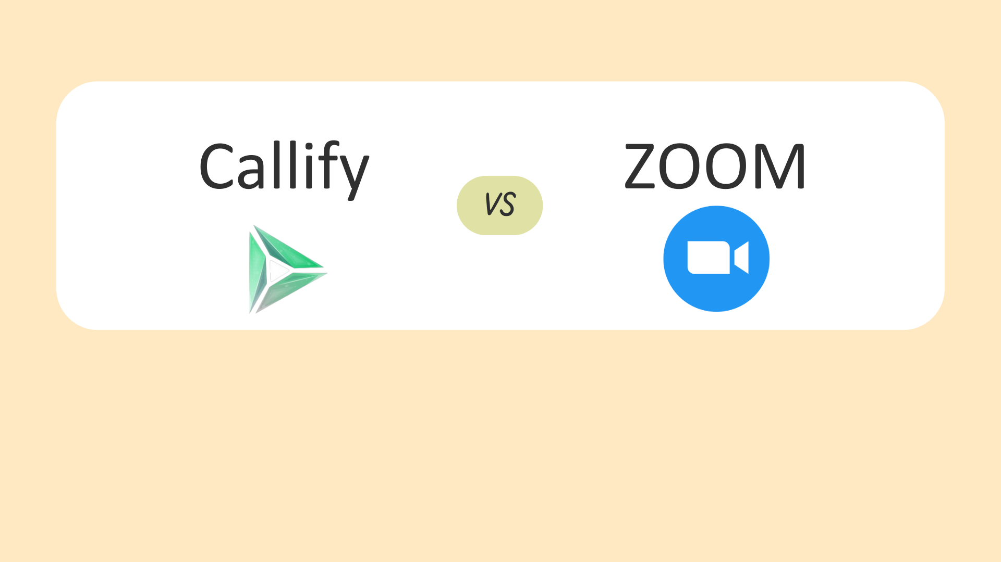
Why Callify is Better compare TO Zoom

Slide 2
Disadvantages of Zoom

Slide 3

Security and Privacy Concerns
Data breaches: Zoom has experienced data breaches in the past.
Encryption issues: Zoom's end-to-end encryption has been questioned.
Privacy concerns: Zoom's data collection and usage policies have raised concerns.
Vulnerabilities: Zoom has had security vulnerabilities, such as the "Zoom bombing" issue.

Slide 4
Technical Issues
Connectivity problems: Poor internet connectivity can cause issues.
Audio and video delays: Delays can disrupt meetings.
Software glitches: Bugs and glitches can cause functionality issues.
Compatibility issues: Zoom may not work seamlessly with all devices or browsers.

Slide 5
Performance and Resource Intensive
High bandwidth usage: Zoom requires significant internet bandwidth.
Resource-intensive: Zoom can consume computer resources, affecting performance.
Battery drain: Mobile devices may experience battery drain during prolonged use.

Slide 6
Cost and Pricing
Costly for large teams: Enterprise plans can be expensive.
Limited features in basic plans: Paid plans are required for advanced features.
Additional costs for add-ons: Some features, like cloud storage, incur extra costs.

Slide 7
Other Disadvantages
Limited virtual event capabilities: Zoom is primarily designed for meetings, not large events.
Data residency issues: Data storage locations may not meet regional regulations.

